Slide 1
INDUSTRIAL CONTROL SYSTEMS
By
Dr. V S Krushnasamy

Slide 2
Real-time control system hardware
Microprocessor units
(b) Programmable peripheral devices (memory chips)
Programmable peripheral interfaces consist of several programmable integrated-circuit units attached to microprocessor units to allow the microprocessor to perform interrupt controlling, timer controlling, and to also control dynamic memory volumes and input/output ports.
(c) Industrial computers and motherboards

Slide 3
Real-time control system hardware
(d) Real-time controllers
Some dedicated controllers are to real-time control. The PLC (programmable logic control) controller is a typical example. Other examples of real-time controllers are CNC (computer numerical control) controllers, PID (proportional-integral-derivative) controllers, servo controllers and batch controllers.
Most modern SCADA (supervisory control access and data acquisition) control systems also contain real-time controllers.

Slide 4
Real-time control System Software

Slide 5
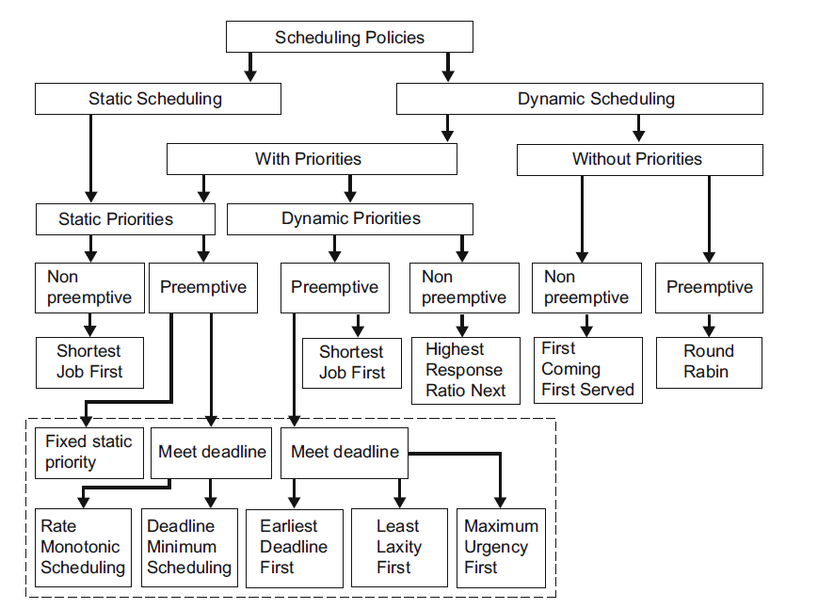
A classification for the most well-known multitasking scheduling algorithms for single microprocessor systems.

Slide 6
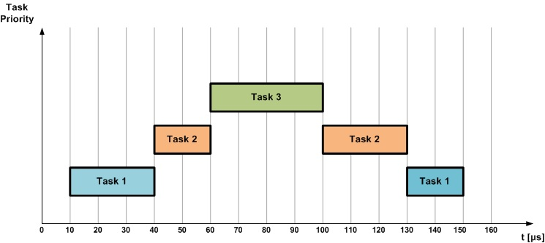
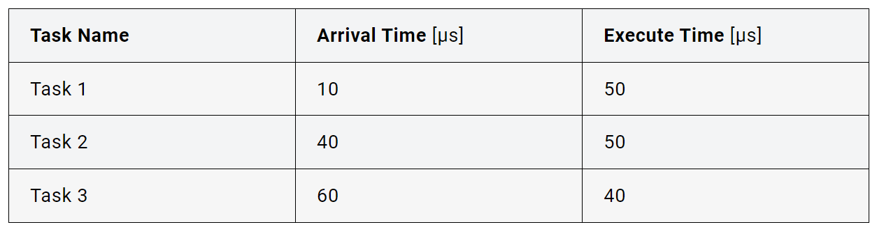
Preemptive Scheduling
Preemptive scheduling allows the interruption of a currently running task, so another one with more “urgent” status can be run. The interrupted task is involuntarily moved by the scheduler from running state to ready state. This dynamic switching between tasks that this algorithm employs is, in fact, a form of multitasking. It requires assigning a priority level for each task. A running task can be interrupted if a task with a higher priority enters the queue.

Slide 7
Preemptive Scheduling
Scenario: Consider an automotive system with the following tasks:
Engine Control (Task 1): Manages the engine's fuel injection timing, ignition timing, and other parameters. This task has high priority and is time-critical.( 10, 50)
Infotainment System Update (Task 2): Handles updates to the car's infotainment system. This task is less critical but still needs to be executed. (30, 60)
Safety Monitoring (Task 3): Monitors the car’s sensors for safety-critical operations such as ABS (Anti-lock Braking System) and ESP (Electronic Stability Program). This task has the highest priority due to its safety-critical nature. (20, 40)

Slide 8
Preemptive Scheduling
Task 1 (Engine Control): Arrival at 10µs, needs 50µs to complete.
Task 2 (Infotainment Update): Arrival at 40µs, needs 50µs to complete.
Task 3 (Safety Monitoring): Arrival at 60µs, needs 40µs to complete.

Slide 9
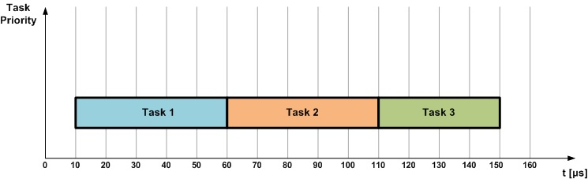
Non-Preemptive Scheduling
In non-preemptive scheduling, the scheduler has more restricted control over the tasks. It can only start a task and then it has to wait for the task to finish or for the task to voluntarily return the control. A running task can’t be stopped by the scheduler.

Slide 10
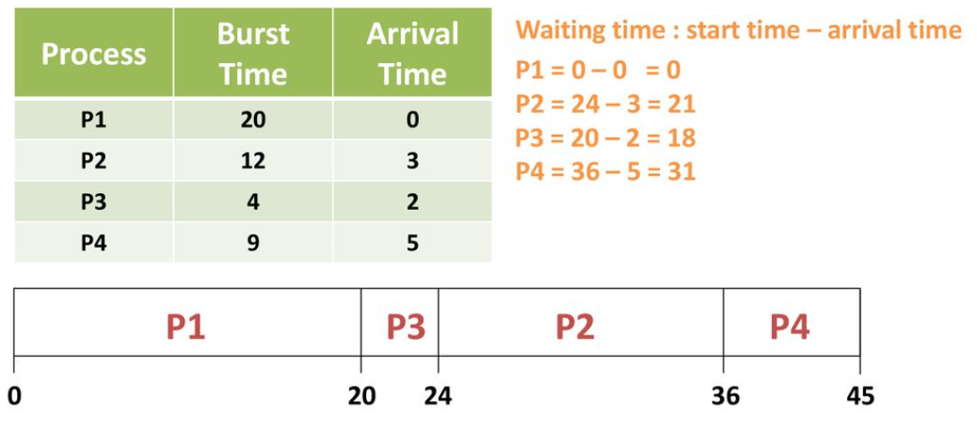
First Come, First Serve – CPU Scheduling | (Non-preemptive)

Slide 11
First Come, First Serve – CPU Scheduling | (Non-preemptive)
Task | Task Description | Arrival Time (seconds) | Burst Time (seconds)
Task 1 | Fuel injection calibration | 0 | 5
Task 2 | Engine temperature monitoring | 1 | 3
Task 3 | Ignition timing adjustment | 2 | 4
Task 4 | Oxygen sensor feedback check | 3 | 2
| Task 1 | Task 2 | Task 3 | Task 4 |
0 5 8 12 14

Slide 12
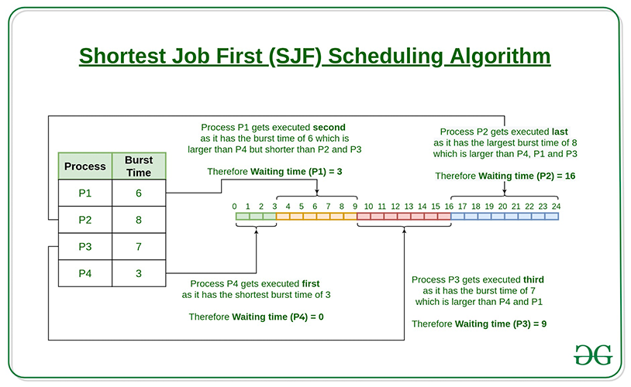

Slide 13
Task | Task Description | Arrival Time (seconds) | Burst Time (seconds)
Task 1 | Fuel injection calibration | 0 | 7
Task 2 | Engine temperature monitoring | 1 | 4
Task 3 | Ignition timing adjustment | 2 | 2
Task 4 | Oxygen sensor feedback check | 3 | 1
| Task 1 | Task 4 | Task 3 | Task 2 |
0 7 8 10 14

Slide 14
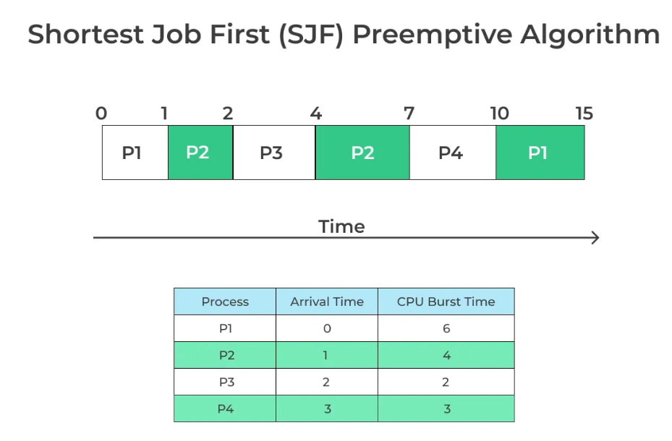

Slide 15
Task | Task Description | Arrival Time (seconds) | Burst Time (seconds)
Task 1 | Fuel injection calibration | 0 | 7
Task 2 | Engine temperature monitoring | 1 | 4
Task 3 | Ignition timing adjustment | 2 | 2
Task 4 | Oxygen sensor feedback check | 3 | 1
| Task 1 | Task 2 | Task 3 | Task 4 | Task 3 | Task 2 | Task 1 |
0 1 2 3 4 5 8 14

Slide 16
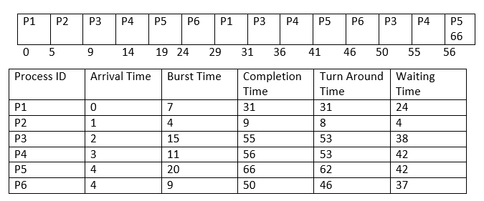
Round Robin

Slide 17
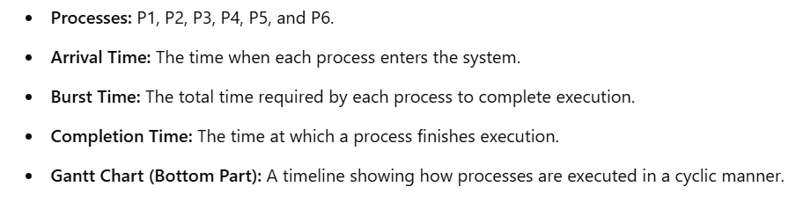
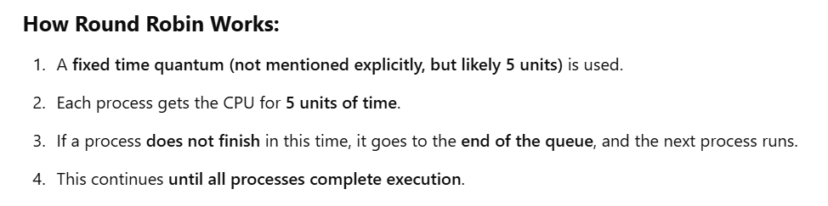

Slide 18
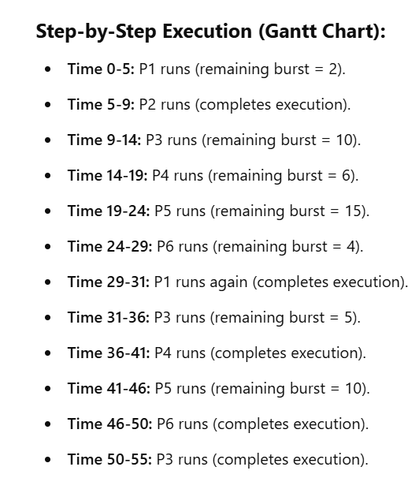


Slide 19
Round Robin
Task | Task Description | Arrival Time (seconds) | Burst Time (seconds)
Task 1 | Fuel injection calibration | 0 | 6
Task 2 | Engine temperature monitoring | 1 | 4
Task 3 | Ignition timing adjustment | 2 | 5
Task 4 | Oxygen sensor feedback check | 3 | 2
| Task 1 | Task 2 | Task 3 | Task 4 | Task 1 | Task 2 | Task 3 | Task 1 | Task 3 |
0 2 4 6 8 10 12 14 15 17

Slide 20
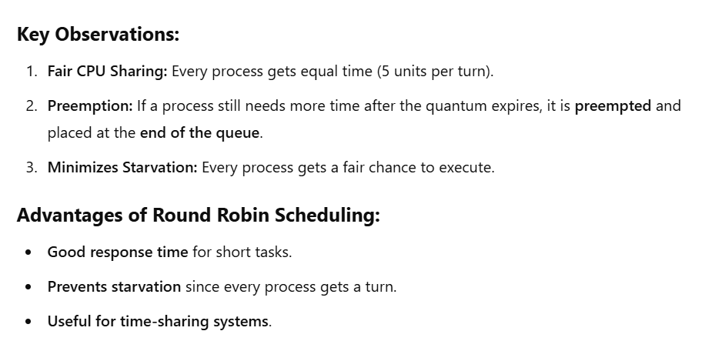

Slide 21
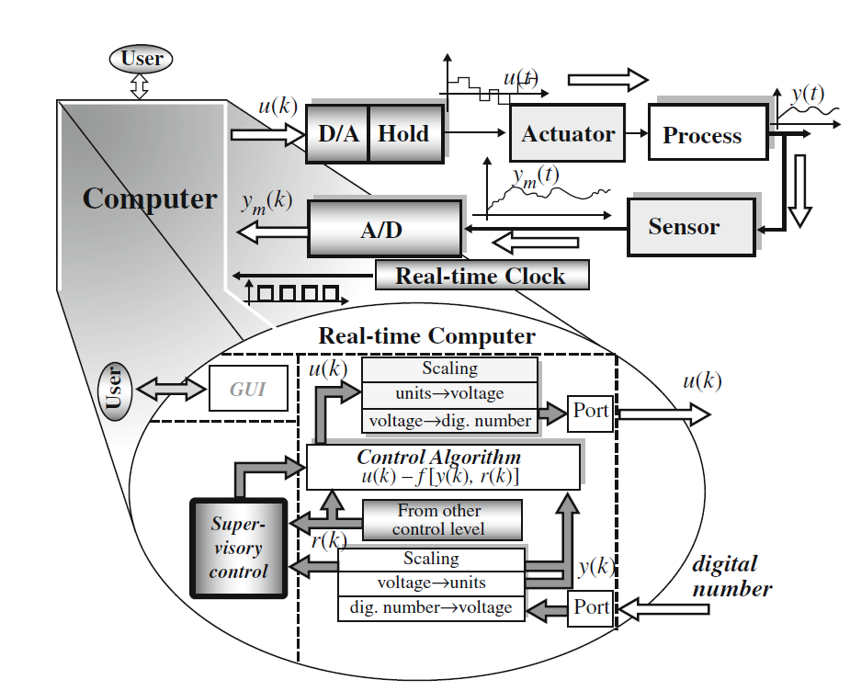
Implementation methods

Slide 22
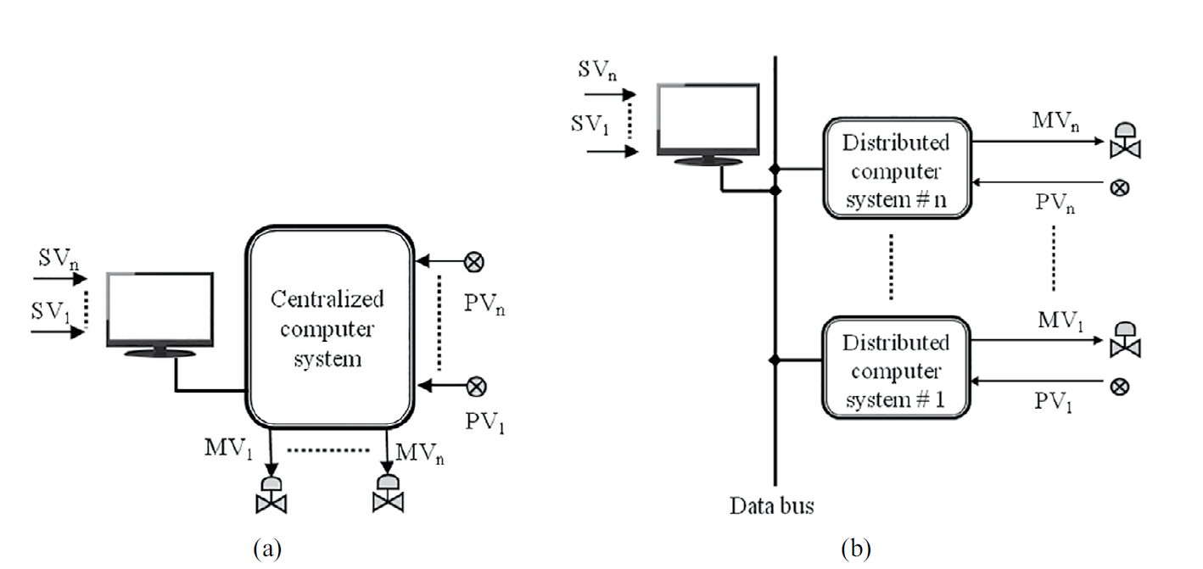
Centralized Computer System
Distributed Control System.

Slide 23
Principles of Distributed Control Systems (DCS) in Process Industries:
Decentralization:
DCS spreads control functions across various locations in a plant. Instead of having a central control room handling all tasks, the control is distributed across different controllers placed near the process equipment.
Modular Architecture:
DCS uses a modular approach, where different controllers are assigned specific tasks or subsystems. Each controller is responsible for a particular section, making it scalable and flexible.
Real-time Monitoring and Control:
A key principle of DCS is real-time data acquisition from sensors and equipment, enabling continuous monitoring and feedback control for process optimization and safety.

Slide 24
Principles of Distributed Control Systems (DCS) in Process Industries:
Hierarchical Control Levels:
DCS integrates multiple control layers, from field devices (sensors, actuators) to supervisory control systems, ensuring smooth communication and coordination across all levels.
Redundancy and Reliability:
Critical components in DCS are often duplicated, ensuring that the system can continue to function even if one part fails, enhancing reliability and uptime.
Data Communication:
DCS relies on digital communication networks, such as Ethernet, to link controllers, field devices, and human-machine interfaces (HMIs), allowing for quick and efficient data exchange

Slide 25
Principles of Distributed Control Systems (DCS) in Process Industries:
Human-Machine Interface (HMI):
Operators interact with the DCS through HMIs, allowing them to monitor the status of the process, analyze trends, and adjust parameters as necessary.
Advanced Process Control (APC):
DCS can incorporate advanced control strategies (e.g., PID controllers, model predictive control), which enhance process efficiency, reduce variability, and improve product quality.

Slide 26
Functions of Distributed Control Systems (DCS) in Process Industries:
Process Control:
The primary function of a DCS is to control the process variables (temperature, pressure, flow, level, etc.) within the desired setpoints using feedback loops and other control algorithms.
Data Acquisition and Logging:
DCS gathers data from field devices, logs it for analysis, and displays it to operators in real time. This data is crucial for monitoring trends, optimizing processes, and maintaining records.
Alarm Management:
DCS generates alarms when process variables deviate from acceptable ranges. It categorizes and prioritizes alarms to help operators quickly respond to abnormal conditions.

Slide 27
Functions of Distributed Control Systems (DCS) in Process Industries:
Batch Control:
In industries like pharmaceuticals and food processing, DCS is used for batch processing, where it controls sequences and schedules of operations, ensuring product consistency.
Recipe Management:
In cases where multiple products or grades are produced, DCS manages different recipes or process configurations and allows seamless switching between them.
Supervisory Control:
DCS integrates supervisory control functions that enable high-level monitoring and coordination between different subsystems, optimizing plant performance.

Slide 28
Functions of Distributed Control Systems (DCS) in Process Industries:
Safety and Emergency Shutdown:
DCS can be integrated with safety systems to ensure that, in the event of critical failures, the process can be safely brought to a halt (emergency shutdown systems).
Remote Control and Monitoring:
Operators can monitor and control processes remotely through network connections, allowing flexibility in managing large plants or geographically distributed facilities.
Energy Management:
DCS helps optimize energy consumption by controlling processes more efficiently, contributing to cost savings and reduced environmental impact.

Slide 29
Functions of Distributed Control Systems (DCS) in Process Industries:
Reporting and Analysis:
DCS systems provide historical data and trends, enabling operators to generate reports, perform root cause analyses, and make informed decisions for process improvement.
Maintenance and Diagnostics:
DCS helps monitor the health of equipment and provides diagnostic data, which aids in predictive maintenance and minimizes unplanned downtime.

Slide 30
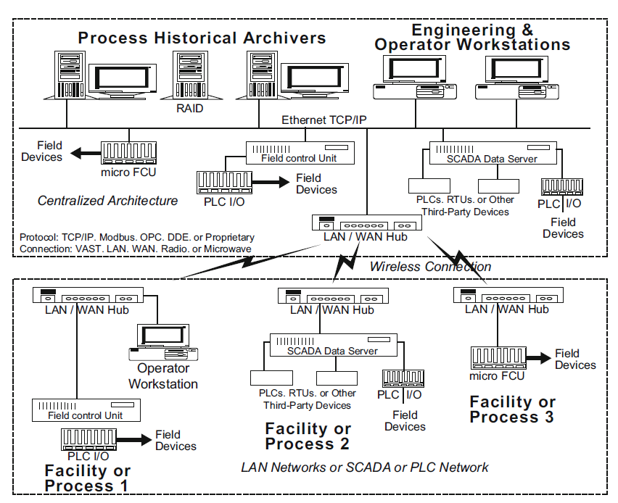
Distributed control system architecture.

Slide 31
Process Historical Archivers
RAID: Redundant Array of Independent Disks (RAID) for secure storage of historical process data.
This section stores historical process data collected from field devices over time for analysis, trends, and reporting.
Data is collected from various field control units and devices and is archived for later use.

Slide 32
Engineering and Operator Workstations
These are operator interfaces or Human-Machine Interfaces (HMIs) used to monitor and control the processes.
Operators can view real-time data, trends, and alarms and can control processes from these workstations.
The workstations are connected via Ethernet TCP/IP to the central servers and control units.

Slide 33
Field Control Unit (FCU) and PLC I/O
Micro FCU and PLC (Programmable Logic Controller) I/O: These units are responsible for interacting with the field devices, such as sensors, actuators, and other control elements.
Field Devices: Connected directly to the FCUs or PLC I/O, the field devices collect data (e.g., temperature, pressure) and send it to the control system for processing and control actions.

Slide 34
Communication Protocols
TCP/IP, Modbus, OPC, DDE: These are communication protocols used to transfer data between different components of the control system.
LAN/WAN (Local Area Network/Wide Area Network): Data is communicated over LAN or WAN networks, either wired or wirelessly.
VAST, LAN, WAN, Radio, Microwave: These are various forms of communication infrastructure that can be used depending on the environment and distance between facilities.

Slide 35
Distributed Architecture:
In the lower portion of the image, you see multiple facilities (Facility 1, Facility 2, Facility 3), each with its own control unit (FCU or PLC I/O), which communicates with a central server through LAN/WAN or wireless connections.

Slide 36
Facility or Process Sections
The image shows three different facilities (Facility 1, 2, and 3), each with their own local control systems, workstations, and field devices:
Facility or Process 1: This shows an Operator Workstation connected to the Field Control Unit (FCU) which interfaces with PLC I/O and field devices.
Facility or Process 2: Here, the architecture includes a SCADA Data Server that collects data from multiple Remote Terminal Units (RTUs), PLCs, and other third-party devices.
Facility or Process 3: In this case, there’s a micro FCU and field devices, connected via LAN/WAN hubs and wireless connections.

Slide 37
LAN Networks or SCADA or PLC Network
The entire system, including multiple facilities, is interconnected via LAN or WAN networks, allowing the SCADA system or PLC to monitor and control operations across various geographical locations.
Wireless Connection
The dashed lines indicate wireless connections between facilities, allowing remote locations to communicate without wired connections.

Slide 38
Implementation Technique
Requirement Analysis
Identify Process Control Needs: Understand the scope of the process, including variables to be controlled (temperature, pressure, flow, etc.), number of control loops, and subsystems.
Regulatory and Safety Requirements: Assess standards and regulations applicable to the industry (e.g., ISO, OSHA) and specific safety requirements like emergency shutdown systems (ESD).
Integration with Existing Systems: Evaluate whether the DCS will be implemented in a new or existing system and how it will integrate with other automation components (e.g., PLCs, SCADA).

Slide 39
Implementation Technique
System Design and Planning
Architectural Design: Determine the type of DCS architecture (centralized or distributed) to be implemented based on the scale of the plant.
Centralized Control Units: Placement of control units in a single location.
Distributed Control Units: Use of distributed controllers across different process sections.
Control Strategy: Define control loops, algorithms (PID, advanced control), and communication protocols (TCP/IP, Modbus, OPC) that the DCS will use.
Network Design: Design the communication network between controllers, field devices, workstations, and servers (LAN/WAN, wireless connections).
Redundancy and Fail-Safe Design: Plan for system redundancy (hot standby controllers, backup power) and fail-safe operations in case of system failure.
Scalability Planning: Design the system to be scalable, allowing future expansion of the plant or the addition of more processes without major reconfiguration.

Slide 40
Implementation Technique
Hardware Selection
Controllers (DCS Nodes): Select appropriate DCS controllers for process control, ensuring they can handle required I/O, processing speed, and functionality.
Field Devices: Choose sensors, actuators, and transmitters compatible with the DCS, ensuring accurate data acquisition and precise control.
Communication Equipment: Select routers, switches, and gateways for the LAN/WAN or wireless networks, ensuring robust communication between field devices and controllers.
Human-Machine Interface (HMI): Choose operator workstations and display units with intuitive interfaces for real-time monitoring and control.

Slide 41
Implementation Technique
Software Configuration
Control Logic Programming: Develop the control logic (e.g., ladder logic, function blocks, structured text) in the DCS system for process control.
HMI Development: Configure HMI screens for operators, ensuring intuitive visual representations of plant operations, alarms, trends, and control options.
Alarm and Event Management: Define alarm thresholds, priorities, and actions in response to abnormal process conditions.
Historical Data Logging: Configure data archiving to ensure the system stores critical process data for long-term analysis and reporting.

Slide 42
Implementation Technique
Installation
Controller and Network Installation: Install the DCS controllers, connect them to field devices, and configure the LAN/WAN or wireless network for communication.
I/O Connection: Connect sensors and actuators to the appropriate input/output (I/O) modules in the controllers.
Server and Workstation Setup: Install the engineering and operator workstations, SCADA servers, and historical data archivers.
Power Supply and Redundancy Setup: Install power supplies, ensuring backup or redundant power for critical components to ensure continuous operation.

Slide 43
Implementation Technique
System Integration
Field Device Integration: Integrate the DCS with all field devices, ensuring accurate and stable data exchange between the controllers and the field.
PLC/SCADA Integration: If the plant already has a PLC or SCADA system, ensure proper data exchange and coordination between these systems and the DCS.

Slide 44
Implementation Technique
Testing and Commissioning
Pre-commissioning: Test the individual components (sensors, actuators, controllers) for functionality and ensure they are correctly installed.
System Testing: Conduct integrated system testing, including validation of control logic, communication networks, alarm functionality, and fail-safe operations.
Performance Testing: Simulate real-world conditions to test the system's performance, including load testing to verify the system’s scalability.
Acceptance Testing: Perform final tests in collaboration with operators to verify that the DCS meets operational requirements.

Slide 45
Implementation Technique
Operator Training
Hands-on Training: Provide operators and maintenance staff with hands-on training on the DCS, including how to navigate HMIs, manage alarms, and interpret trends.
Emergency Procedures: Train operators on responding to system failures or alarms and performing emergency shutdowns.
Maintenance Training: Equip maintenance teams with the knowledge to troubleshoot common issues and conduct routine system maintenance.

Slide 46
Implementation Technique
Go-live and Monitoring
System Launch: Once testing is complete, start up the system for real-time operation, ensuring all processes are stable and control loops function as designed.
Fine-tuning: During the initial operation period, fine-tune control parameters based on process performance and operator feedback.
Continuous Monitoring: Implement continuous performance monitoring, logging data for periodic review and process optimization.

Slide 47
Implementation Technique
Maintenance and Upgrades
Preventive Maintenance: Schedule regular system maintenance to check controller health, network stability, and field device performance.
Software Updates: Ensure that software is periodically updated for security patches and to enhance system functionality.
Hardware Upgrades: As needed, upgrade hardware components like controllers or HMIs to improve system performance or to add more functionality.
Expansion: If the plant expands, integrate new process sections seamlessly into the existing DCS architecture.

Slide 48
Implementation Technique
Documentation
Process Documentation: Create detailed documentation of the control system, including the control logic, system architecture, network diagrams, and user manuals.
Change Log: Maintain a log of any changes made to the system after implementation (e.g., configuration changes, software updates) for future reference.

Slide 49
Implementation Technique
Post-Implementation Review
Performance Evaluation: Review system performance after a set period to ensure that it meets all operational and efficiency goals.
Operator Feedback: Gather feedback from operators to identify any potential improvements or adjustments in the system’s configuration.
Optimization: Continuously analyze performance data and optimize control loops or process variables to improve efficiency and product quality.

Slide 50
Distributed control system architecture.
Hardware components
Operator interfaces
I/O subsystem
Connection buses
Field control units
Wireless subsystem
Component redundancy

Slide 51
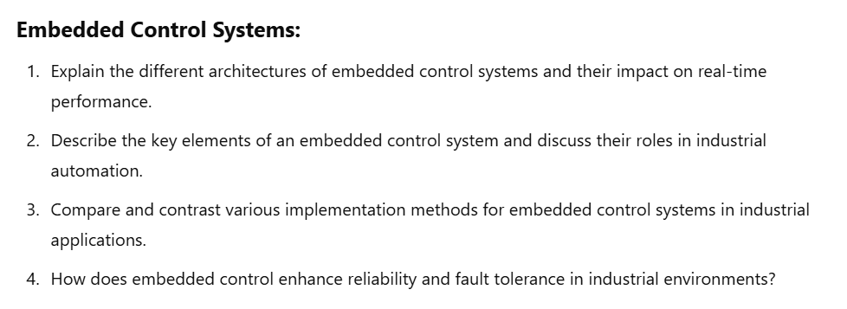
Questions

Slide 52
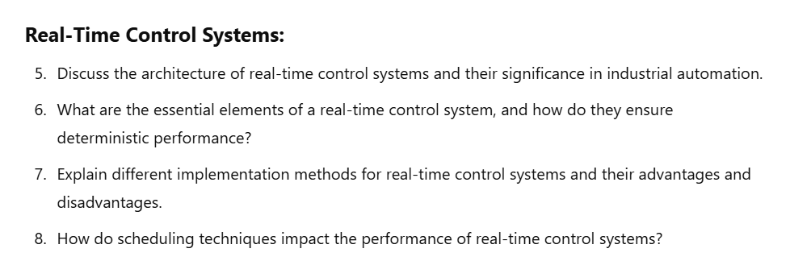

Slide 53
